Slide 1
INTRODUCTION TO SERVER SIDE SCRIPTING

Slide 2
Introduction
HTTP is a communication standard governing the requests and responses that take place between the browser running on the end user’s computer and the web server.
Between the client and the server there can be several other devices, such as routers, proxies, gateways, dns and so on.

Slide 3
Introduction
A web server can usually handle multiple simultaneous connections and—when not communicating with a client—spends its time listening for an incoming connection.
When one arrives, the server sends back a response to confirm its receipt.

Slide 4
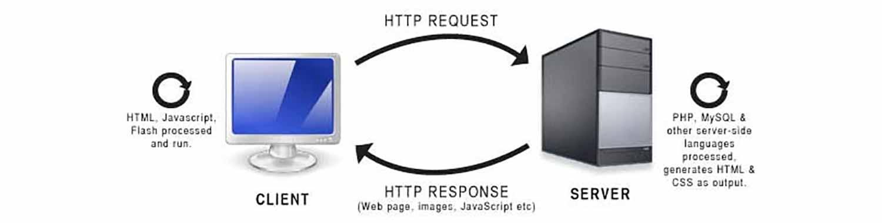
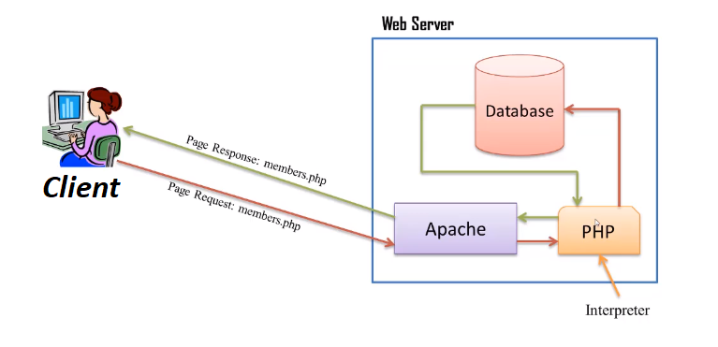

Slide 5
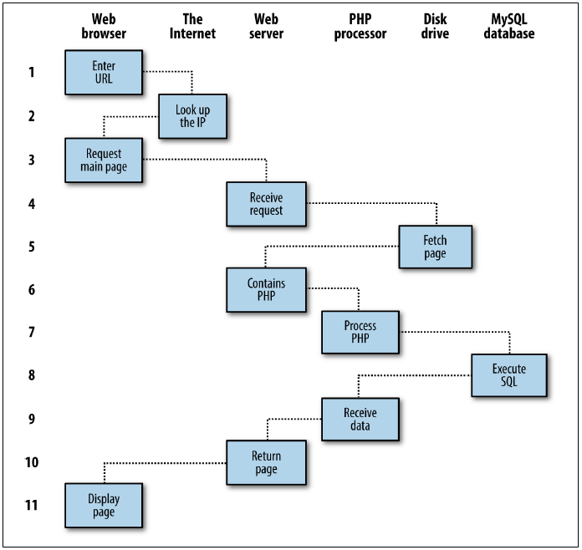
The Request/Response Procedure

Slide 6
The Request/Response Procedure
1. You enter http://server.com into your browser’s address bar.
2. Your browser looks up the IP address for server.com.
3. Your browser issues a request to that address for the web server’s home page.
4. The request crosses the Internet and arrives at the server.com web server.
5. The web server, having received the request, fetches the home page from its hard disk.
6. With the home page now in memory, the web server notices that it is a file incorporating PHP scripting and passes the page to the PHP interpreter.

Slide 7
The Request/Response Procedure
7. The PHP interpreter executes the PHP code.
8. Some of the PHP contains MySQL statements, which the PHP interpreter now passes to the MySQL database engine.
9. The MySQL database returns the results of the statements to the PHP interpreter.
10. The PHP interpreter returns the results of the executed PHP code, along with the results from the MySQL database, to the web server.
11. The web server returns the page to the requesting client, which displays it.

Slide 8
Apache Web Server
Apache doesn’t serve up just HTML files—it handles a wide range of files from images and Flash files to MP3 audio files, RSS (Really Simple Syndication) feeds, and so on.
PHP running on Apache can even create images and other files for you, either on the fly or in advance to serve up later.
To do this, you normally have modules either precompiled into Apache or PHP or called up at runtime.

Slide 9
Requirements for Server Side Scripting
A computer running on Windows/Linux
A web server preferably running on Apache
PHP – ideally the most recent version
Database – Ideally MySQL
Or if you prefer, you may install a package comprising of all the necessary application to host your web application (WAMP, MAMP, LAMP, or XAMPP)
Ideally, we can agree on XAMPP because it is probably the best there is for development

Slide 10
Introduction to PHP
PHP is the language that you use to make the server generate dynamic output
your web pages will be a combination of PHP, HTML, and JavaScript, and some MySQL statements laid out using CSS, and possibly utilizing various HTML5 elements.
By default, PHP documents end with the extension .php
To trigger the PHP commands, you need a new tag <?php and close with another tag ?>

Slide 11
Hello World
The Hello world to display on the browser
<?php
echo "Hello world";
?>
<?php
// This is a comment
/* This is a section
of multiline comments
which will not be
interpreted */
?>

Slide 12
The $ symbol
you must place a $ in front of all variables
array()
Two-dimensional array
Example : Three different types of variable assignment
<?php
$mycounter = 1;
$mystring = "Hello";
$myarray = array("One", "Two", "Three");
?>
$team = array('Bill', 'Mary', 'Mike', 'Chris', 'Anne');
echo $team[3]; // Displays the name Chris
Example : Defining a two-dimensional array
<?php
$oxo = array(array('x', ' ', 'o'),
array('o', 'o', 'x'),
array('x', 'o', ' '));
?>

Slide 13
Array
Numerical indexed array – array contents are indexed numerically
Example : Adding items to an array and retrieving them
<?php
$paper[] = "Copier";
$paper[] = "Inkjet";
$paper[] = "Laser";
$paper[] = "Photo";
for ($j = 0 ; $j < 4 ; ++$j)
echo "$j: $paper[$j]<br>";
?>
This example prints out the following:
0: Copier
1: Inkjet
2: Laser
3: Photo

Slide 14
Array
Associative array – reference the items in an array by name
Example : Adding items to an associative array and retrieving them
<?php
$paper['copier'] = "Copier & Multipurpose";
$paper['inkjet'] = "Inkjet Printer";
$paper['laser'] = "Laser Printer";
$paper['photo'] = "Photographic Paper";
echo $paper['laser'];
?>
Example : Walking through an associative array using foreach...as
<?php
$paper = array('copier' => "Copier & Multipurpose", 'inkjet' => "Inkjet Printer",
'laser' => "Laser Printer", 'photo' => "Photographic Paper");
foreach($paper as $item => $description)
echo "$item: $description<br>";
?>

Slide 15
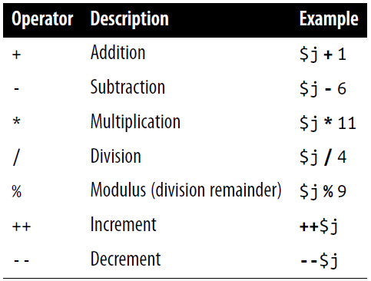
Operators
The operators work similar to those of other programming languages
The same order of precedence still applies

Slide 16
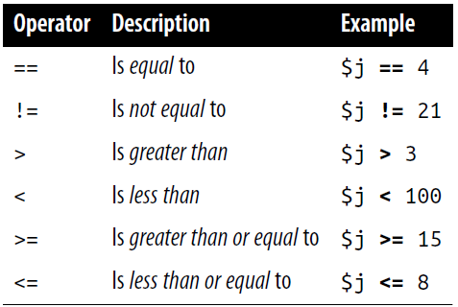
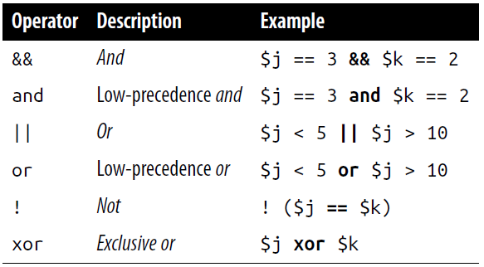
Logical operators

Slide 17
String concatenation
String concatenation uses the period (.) to append one string of characters to another
PHP supports two types of strings, denoted by the type of quotation mark that you use.
a literal string preserves the exact contents; use the single quotation mark (apostrophe)
to include the value of a variable inside a string; use double-quoted strings
echo "You have " . $msgs . " messages.";
$info = 'Preface variables with a $ like this: $variable'; //$variable is not evaluated
echo "This week $count people have viewed your profile"; //$count will be the value of it

Slide 18
PHP Functions
Functions are used to separate out sections of code that perform a particular task
Example : A simple function declaration
<?php
function longdate($timestamp){
return date("l F jS Y", $timestamp);
}
?>
echo longdate(time()); //function call
Example : Returning multiple values in an array
<?php
$names = fix_names("WILLIAM", "henry", "gatES");
echo $names[0] . " " . $names[1] . " " . $names[2];
function fix_names($n1, $n2, $n3)
{
$n1 = ucfirst(strtolower($n1));
$n2 = ucfirst(strtolower($n2));
$n3 = ucfirst(strtolower($n3));
return array($n1, $n2, $n3);
}
?>

Slide 19
Variable Types
Local variables - created within, and can be accessed only by, a function and are temporary
Global variables – all your code to be able to access it
Static variables - a local variable inside a function that you don’t want any other parts of your code to have access to, but you would also like to keep its value for the next time the function is called
global $is_logged_in;

Slide 20
Variable Types
Example:.A function using a static variable
<?php
function test()
{
static $count = 0;
echo $count;
$count++;
}
?>
Example: Allowed and disallowed static variable declarations
<?php
static $int = 0; // Allowed
static $int = 1+2; // Disallowed (will produce a Parse error)
static $int = sqrt(144); // Disallowed
?>

Slide 21
Variable Types
Superglobal variables - provided by the PHP environment but are global within the program, accessible absolutely everywhere
Best to sanitize superglobals in the code
Using the htmlentities function for sanitization is an important practice in any circumstance where user or other third-party data is being processed for output, not just with superglobals.
$came_from = htmlentities($_SERVER['HTTP_REFERER']);

Slide 22
Variable Types
Superglobal Name | Contents
$GLOBALS | All variables that are currently defined in the global scope of the script. The variable names are the keys of the array.
$_SERVER | Information such as headers, paths, and script locations. The entries in this array are created by the web server, and there is no guarantee that every web server will provide any or all of these.
$_GET | Variables passed to the current script via the HTTP Get method.
$_POST | Variables passed to the current script via the HTTP Post method.
$_FILES | Items uploaded to the current script via the HTTP Post method.
$_COOKIE | Variables passed to the current script via HTTP cookies.
$_SESSION | Session variables available to the current script.
$_REQUEST | Contents of information passed from the browser; by default, $_GET, $_POST, and $_COOKIE.
$_ENV | Variables passed to the current script via the environment method.

Slide 23
Conditionals
The if condition can be any valid PHP expression
The action is taken when an if condition is TRUE
when a condition is not TRUE, but you want to continue, you need to use else
With an if...else statement, the first conditional statement is executed if the condition is TRUE. But if it’s FALSE, the second one is executed
the elseif statement in if...elseif...else construct is used when you want a number of different possibilities to occur

Slide 24
Conditionals
The switch statement is useful in cases in which one variable or the result of an expression can have multiple values
Example : A switch statement
<?php
switch ($page){
case "Home":
echo "You selected Home"; break;
case "About":
echo "You selected About"; break;
case "News":
echo "You selected News"; break;
case "Login":
echo "You selected Login"; break;
case "Links":
echo "You selected Links"; break;
default:
echo "Unrecognized selection";break;
}
?>
Example : A multiple-line if...elseif...statement
<?php
if ($page == "Home") echo "You selected Home";
elseif ($page == "About") echo "You selected About";
elseif ($page == "News") echo "You selected News";
elseif ($page == "Login") echo "You selected Login";
elseif ($page == "Links") echo "You selected Links";
?>

Slide 25
Looping
using a while loop continuously executes and checks for the condition to stay TRUE
slight variation to the while loop is the do...while loop, used when you want a block of code to be executed at least once and made conditional only after that
the for loop, is also the most powerful, as it combines the abilities to set up variables as you enter the loop, test for conditions while iterating loops, and modify variables after each iteration

Slide 26
Looping
Example : A while loop to print the 12 times table
<?php
$count = 0;
while (++$count <= 12)
echo "$count times 12 is " . $count * 12 . "<br>";
?>
Example : A do...while loop for printing the times table for 12
<?php
$count = 1;
do {
echo "$count times 12 is " . $count * 12;
echo "<br>";
} while (++$count <= 12);
?>
Example : The for loop with added curly braces
<?php
for ($count = 1 ; $count <= 12 ; ++$count){
echo "$count times 12 is " . $count * 12;
echo "<br>";
}
?>

Slide 27
PHP Session
Sessions provide a solid way of keeping track of users
Starting a session requires calling the PHP function session_start before any HTML has been output
To save a session variable, issue
To read a session variable, issue
To remove a session variable, issue
$_SESSION['variable'] = $value;
$variable = $_SESSION['variable'];
session_destroy();
Example : A handy function to destroy a session and its data
<?php
function destroy_session_and_data(){
session_start();
$_SESSION = array();
setcookie(session_name(), '', time() - 2592000, '/');
session_destroy(); } ?>

